Slide 1
工作汇报
2018年10月17日

Slide 2
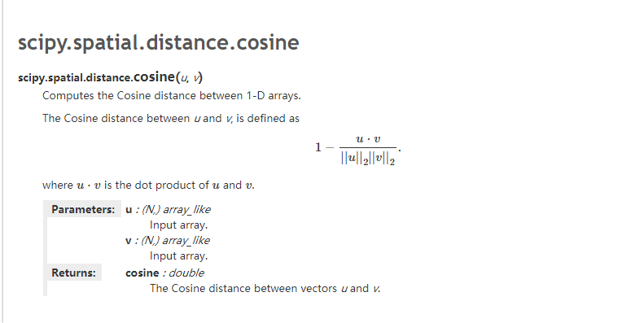
Compute cosine distance
Notes:
采用不同的特征表达形式可以构造出不同的滤波组

Slide 3
Model configuration
Train:
Batch size:400
Uniform_init_scale:random initscale
Learning_rate 0.0005 The learning rate of Adam
Uniform_init_scale 0.1 The random init scale
Clip_gradient_norm 5.0 gradient clipping norm,to protect gradient explosion
Save_model_secs 600 save model ever 600s
Save_summaries_secs:600 save log ever 600s
Nepochs 1 number of epochs
Num_train_inst Number of training instances
Max_ckpts 5 max number of ckpts to keep
Num_input_reader_threads 1 input data reader threads
Learning_rate_decay_steps 400000 learning rate decay every 400000 steps
sequence_length 30 Max sentence length considered
Context_size 1 Prediction context size
Notes:
采用不同的特征表达形式可以构造出不同的滤波组

Slide 4
Data processing
Total sentences: 3049353
1.Delete the sentences which has less than three words (2775989)
2.Encode and save to a npy file
3.Divided into 10 sentences aggregation
4.Make cluster for every sentences aggregation by autotuned algorithm in flann
5.For every test sentences ,find ten nearest neighbours,get their cos similarity
6.Compare the meaning
Notes:
采用不同的特征表达形式可以构造出不同的滤波组

Slide 5
Q&A

